Slide 1
NOTE TO PRAESIDIUM
A full detailed report is still required to be submitted to Senatus together with this slide deck.
Presentation of the report must be kept within 5mins.
Do share with us pictures of your pdm work (if any).

Slide 2
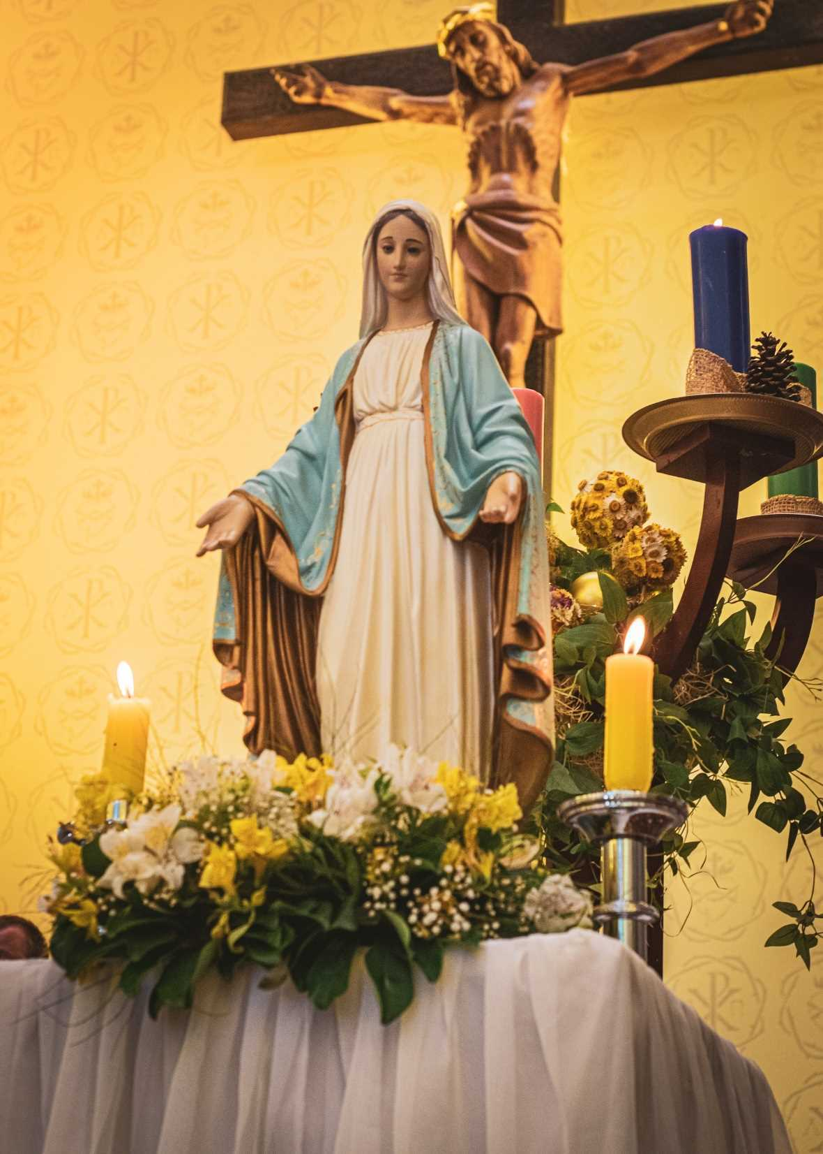

PRAESIDIUM REPORT
<<INPUT PRAESIDIUM NAME HERE>>
ANNUAL REPORT NO. :
Year:

Slide 3
About Us
 | Spiritual Director | President | Vice President | Secretary | Treasurer
Name :
Term Served :
No. of Meetings :
Meeting Day :
Meeting Time :
Meeting Venue :

Slide 4
MEMBERSHIP
 | Start Period |  |  | End Period
 | Total No. | No. of Brothers | No. of Sisters | Total No. | No. of Brothers | No. of Sisters
Active
Probationary
Auxiliary
Praetorians
Adjutorians

Slide 5
ATTENDANCE
Meetings
 | President | Vice President | Secretary | Treasurer
Senatus | % | % | % | %
Praesidium | % | % | % | %
Functions
FUNCTION | ATTENDANCE
ACIES
OUTDOOR FUNCTION
DAY OF RECOLLECTION
ANNUAL GENERAL REUNION

Slide 6
TREASURER STATEMENT
Balance Brought Forward as of << START PERIOD>> | $
Add: Total Income | $
Sub- Total | $
Less: Total Expenses | $
Balance Carried Forward as of << END PERIOD>> | $

Slide 7
SPECIAL WORK FEATURE
<< Asides from the Daily legion works (i.e hospital visits, parish works, home visitation ,etc.) , share with us 1 or 2 works that the praesidium does to grow / promote the Legion to others. Feel free share with us pictures too! >>

Slide 8
FUTURE WORKPLANS
<< Share with us your plans to grow the legion>>

Slide 9
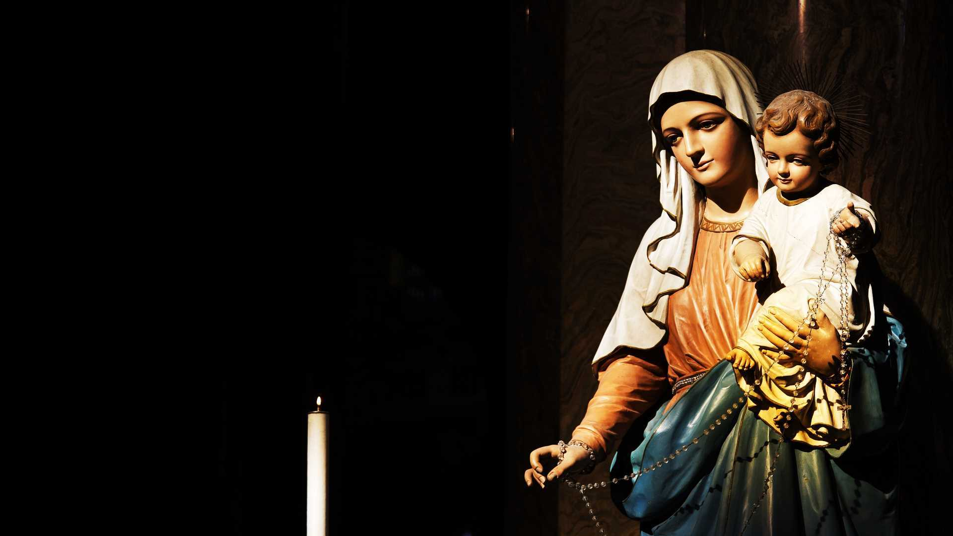
Thank You

