Slide 1
NOTE TO CURIA
A full detailed report is still required to be submitted to Senatus together with this slide deck.
Presentation of the report must be kept within 5mins.
Do share with us pictures of your curia work (if any).

Slide 2
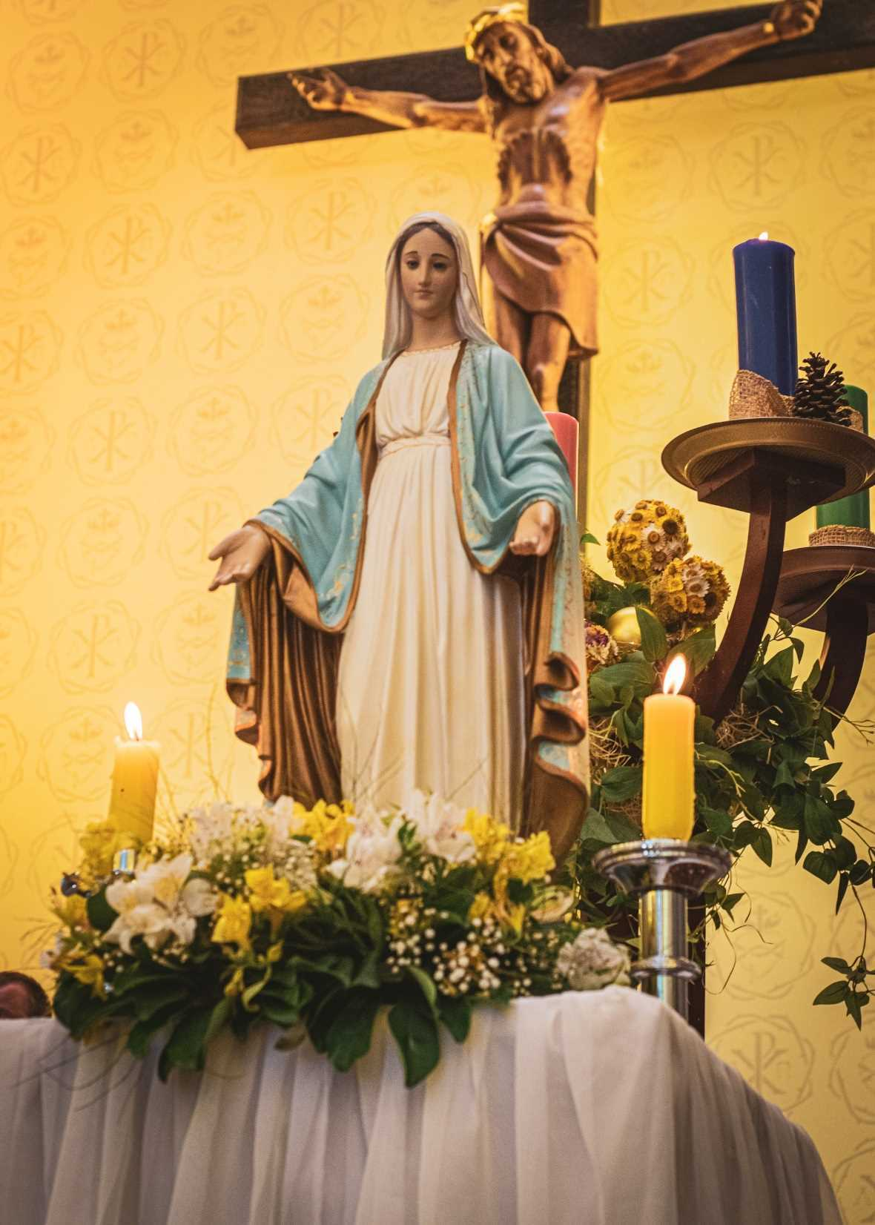

CURIA QUARTLY REPORT
<<INPUT CURIA NAME HERE>>
FOR THE MONTH:

Slide 3
ATTENDANCE
MONTH | PERCENTAGE (%)
TREASURER STATEMENT
Balance as of MMYY : $

Slide 4
CURIA ACTIVTIES
<< Share with us on the activities that happened in the Curia recently. Feel free share with us pictures too! >>

Slide 5
PRAESIDIA VISITED
Name of Praesidium
No. of Praesidia Visited : _____
PRAESIDIA REPORTS READ
No. of Reports Read : _____
Name of Praesidium | Report No. | Year

Slide 6
PRAESIDIA ACTIVTIES
<< Asides from the Daily legion works (i.e hospital visits, parish works, home visitation ,etc.) , share with us 1 or 2 works that the praesidium does to grow / promote the Legion to others. Feel free share with us pictures too! >>

Slide 7
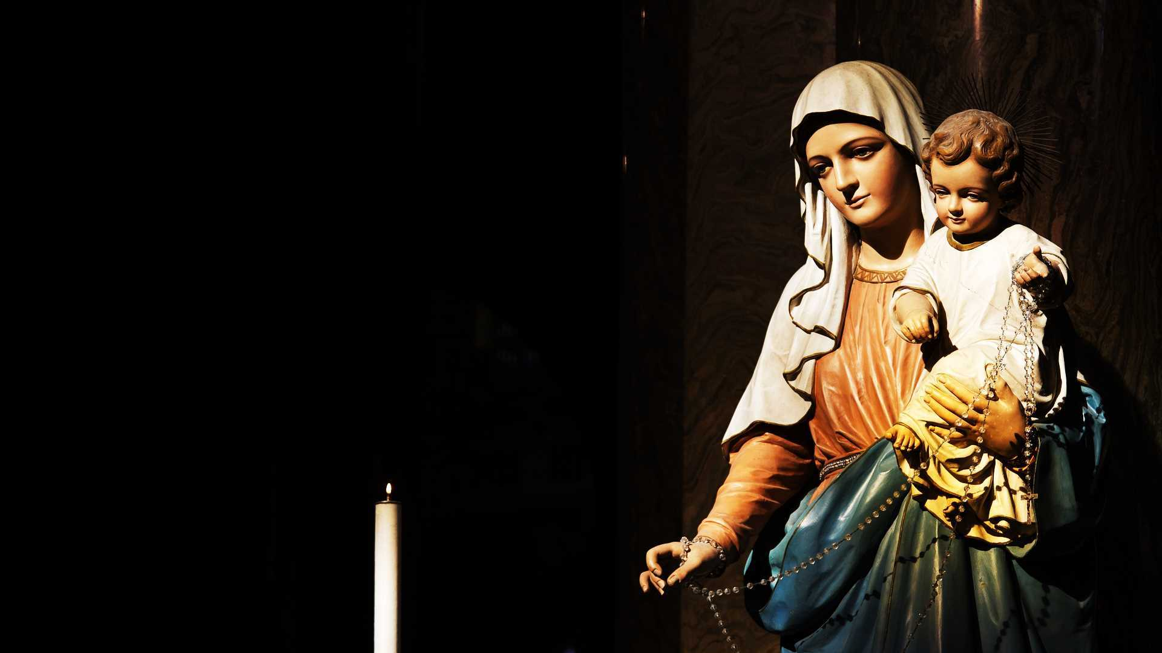
Thank You

